Slide 1
Financial Reporting
Financial reporting is concerned with how accounting data can best be communicated to users of financial statements in accordance with legal and professional requirements.
Normally Company Act requires companies to prepare accounts for each year and share the annual report and accounts with the shareholders and every debenture holder of the company
A copy of the report and accounts must also be filed with the Registrar of Companies. This process is referred to as ‘disclosure of information’ or ‘published accounts’.
This section covers the following :
  The annual report
  The annual accounts
  Interpretation of accounts
For of financial report we shall focus on public companies but most of the information is relevant to other entities. Annual reports may range from 50 to 100 pages

Slide 2
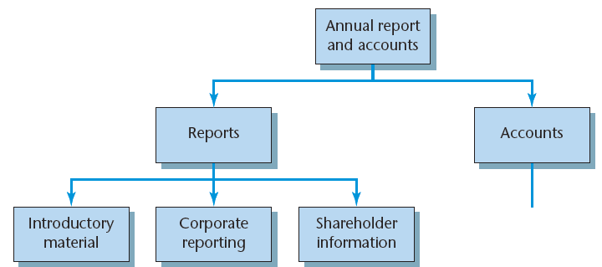
Annual report structure

Slide 3
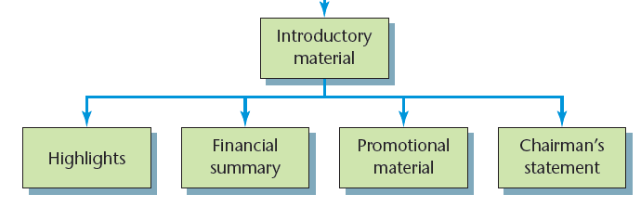
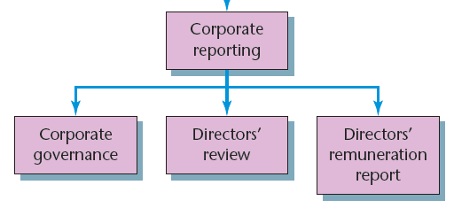
Annual Report: Introductory Material
Annual Report: Corporate Reporting

Slide 4
Annual Report: Introductory Material
Highlights: An overview of the company and its performance
Financial summary: Brief financial summary of the company’s performance
Promotional material: To promote company’s products, shareholder may also become clients
Chairman’s statement: Recent performance of the company and they are usually extremely optimistic about the future

Slide 5
Annual Report: Corporate Reporting
Corporate governance: To assure the stakeholders that the directors know what they are doing, how they are going about it and how successful they have been
Directors’ report:
  General content (names of directors, principle activities, amount dividends recommended)
  Business review (business, uncertainties, developments, contracts, trends in performance)
  Auditors (directors are aware that all relevant information has been given to the auditors)
Directors’ remuneration report: To let shareholders know what the company is paying the directors to act on the shareholders’ behalf.

Slide 6
Shareholder information
Administrative matters:
  annual general meeting
  when the dividend may be paid,
  details about online shareholder services and share dealing,
  the names and addresses of
  the company officers and advisers
Financial summary: Financial results over the last five or 10 years
Glossary of terms: list of the financial and technical terms used in their annual
report and accounts

Slide 7
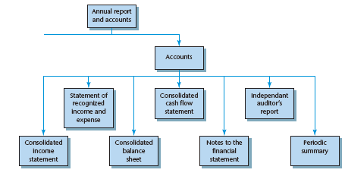
Annual Accounts Structure

Slide 8
International financial reporting standards
Main requirements affecting the presentation of published accounts:
  IAS 1 Presentation of Financial Statements (overall requirements for the presentation of financial statements)
  IAS 7 Statement of Cash Flows (present information on how an entity’s cash and cash equivalents changed during the period)
  IAS 27 Separate Financial Statements (accounting and disclosure requirements for investments in subsidiaries, joint ventures and associates when an entity elects to present separate financial statements)
  IAS 28 Investments in Associates and joint ventures (investor to account for its investment in associates using the equity method
  IFRS 11 Joint Arrangements (investor to account for its investments in joint ventures using the equity method)
Normally corresponding figures for the preceding year will be included side by side with the current year
Most published accounts will be for a group of companies

Slide 9
Group accounts
We refer to groups when one company (say Company A) may buy shares in another company (say Company B)
If Company A owns more than 50 per cent of the voting shares in Company B, B becomes a subsidiary of A.
If A were to own more than 20 per cent but less than 50 per cent of the voting shares in B, B would be known as an associated company of A.
B is considered to be the offspring of A
Standards require company to publish accounts of the group i.e. consolidated reports

Slide 10
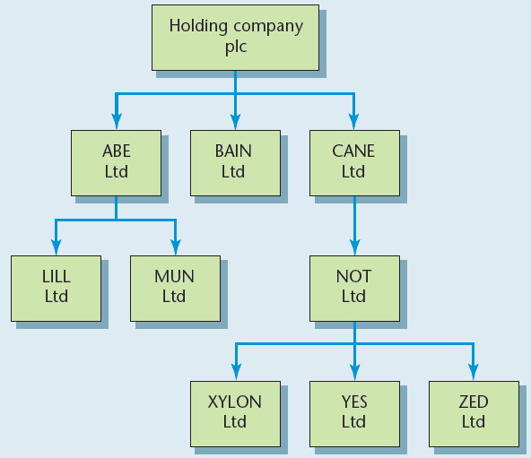
Group Company Structure

Slide 11
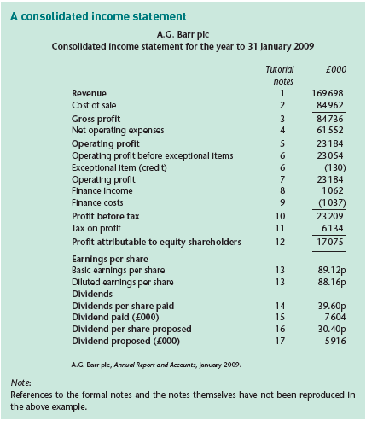

Slide 12
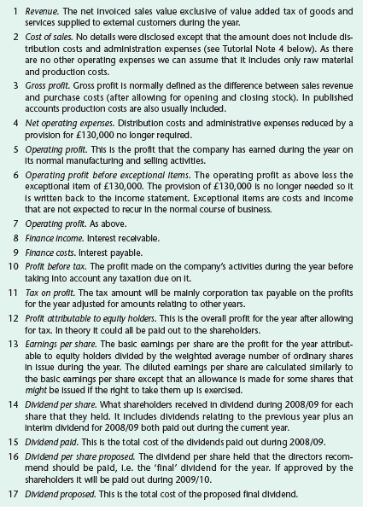

Slide 13
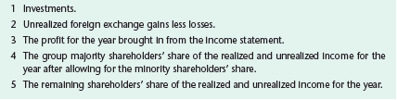
Statement of recognized income and expense
IAS require Statement of Changes in Equity. Alternative version is permitted: the Statement of Total Recognized Gains and Losses
Notes

Slide 14
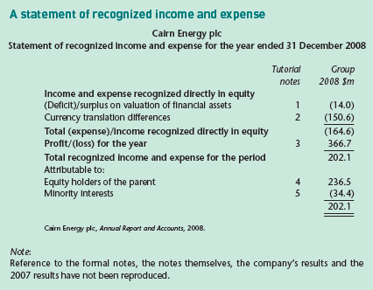

Slide 15
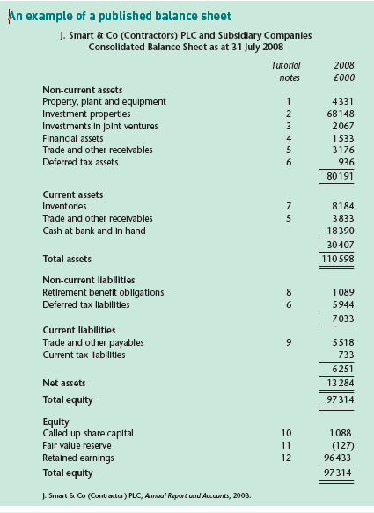

Slide 16
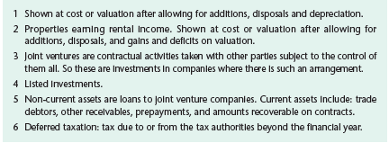
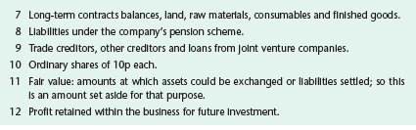

Slide 17
Consolidated cash flow statement
Accounting Standards Board (ASB) was issuing standards in UK while International Accounting Standards Board (IASB) issuing International Standards.
Main differences between ASB’s FRS 1 and the IASB’s IAS 7:
  Exemptions: IAS 7 does not permit any exemptions.
  Definition of cash: FRS 1 uses a narrow definition of cash whereas IAS 7 includes ‘cash equivalents’.
  Presentation: FRS 1 requires eight main headings: operating activities, returns on investments and servicing of finance, taxation, capital expenditure and financial investment, acquisitions and disposals, equity dividends paid, management of liquid resources, and financing. IAS 7 uses three main headings: operating, investing and financing.
  Disclosures: FRS 1 requires some disclosures to be made about ‘net debt’; IAS 7 does not make this a formal requirement

Slide 18
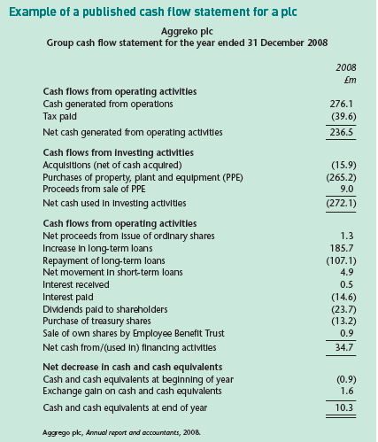

Slide 19
Notes to the financial statements
The income statement, the statement of recognized income and expense and the balance sheet are usually supported by additional notes
Notes serve two main purposes:
  Avoid too much detail being shown on the face of the financial statements
  Make it easier to provide some supplementary information.

Slide 20
Independent auditor’s report
Independent auditors have audited not only the financial statements but also parts of the director’s remuneration report.
Statement explaining the respective responsibilities of the directors and of the auditors.
The audit has been conducted on the basis of international auditing standards
The auditors explain what was involved in doing the audit.
Auditors confirm that the group financial statements give a ‘true and fair’ view for the period in question.
The opinion is in accordance with IFRS requirements and the provision of the Companies Act and IAS regulations.

Slide 21
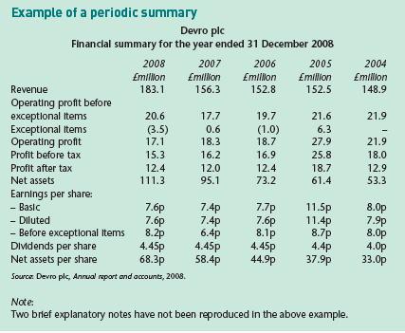
Periodic summary
Not IASB requirements to produce such a summary companies
Usually it covers is five years
Most periodic summaries you will include some details about the sales revenue, gross profit, profit before tax, and dividends paid

Slide 22
Interpretation of Accounts
A detailed explanation of the financial performance of an entity incorporating data and other quantitative and qualitative information extracted from both internal and external sources
Annual reports and account much as they provide a lot of information, they have limitations including:
  Structural: Financial accounts are prepared on the basis of a series of accounting rules. Mainly information that can be translated easily into quantitative financial terms is usually included.
  Absolute: The monetary figures are presented almost solely in absolute terms e.g. UGX 40 million profit
  Contextual: Need to be put in context perhaps by comparing them with previous years’ results or with companies in the same industry.
This can be addressed by interpreting through analysis

Slide 23
Procedure for Interpreting accounts
Interpretation of accounts involves four main stages:
  Collecting the information: general review of the international economic, financial, political and social climate and a more specific one of the country
  Analyzing information: making sense out of information by putting the information into context
  Interpreting information: interpret or to explain what has happened
  Reporting the findings: document your findings by preparing a report comprising of introduction, findings, conclusion and recommendations

Slide 24
Analysis
Horizontal analysis: Compare different periods e.g. percentage increase
Trend Analysis: Similar to horizontal analysis except that all the figures in the first set of accounts (year) in a series are given a base line of 100 and the subsequent sets of accounts are converted to that base line. E.g 40/40X100, 60/40X100
Vertical Analysis: Elements in a specific financial statement are compared e.g. by dividing elements.
Ratio analysis. A ratio is simply the division of one arithmetical amount by another arithmetical amount expressed as a percentage or as a factor. In accounting ratio analysis is the mostly used for interpreting annual reports and accounting

Slide 25
 | Formula |  | Formula | 2017 | 2018 | 2019
Profit and Loss |  | Profit |  | 40 | 60 | 75
 |  | Sales |  | 50 | 80 | 100
Horizontal Analysis | Percetage increase | Profit | Percetage increase |  | 50% | 25%
 |  | Sales |  |  | 60% | 25%
Trend analysis | 2017 is abseline | Profit | 2017 is abseline | 100 | 150 | 187.5
 |  | Sales |  | 100 | 160 | 200
Vertical Analysis | Profit/Sales |  | Divide the elements | 80% | 75% | 75%

Slide 26
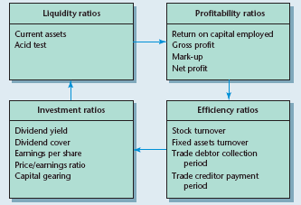
Ratio analysis
Broad categories of ratios accounting are liquidity ratios, profitability ratios, efficiency ratios and investment ratios

Slide 27
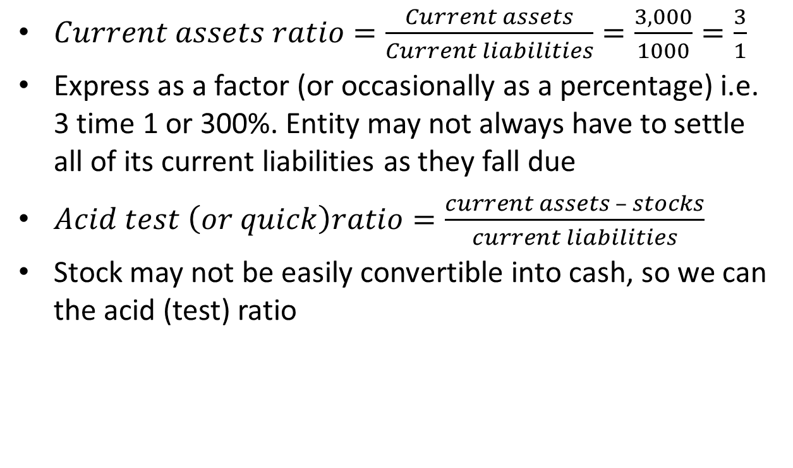
Liquidity ratio
$Current assets ratio=\frac{Current assets}{Current liabilities}=\frac{3,000}{1000}=\frac{3}{1}$
Express as a factor (or occasionally as a percentage) i.e. 3 time 1 or 300%. Entity may not always have to settle all of its current liabilities as they fall due
$Acid test \left(or quick\right)ratio=\frac{current assets – stocks}{current liabilities}$
Stock may not be easily convertible into cash, so we can the acid (test) ratio

Slide 28
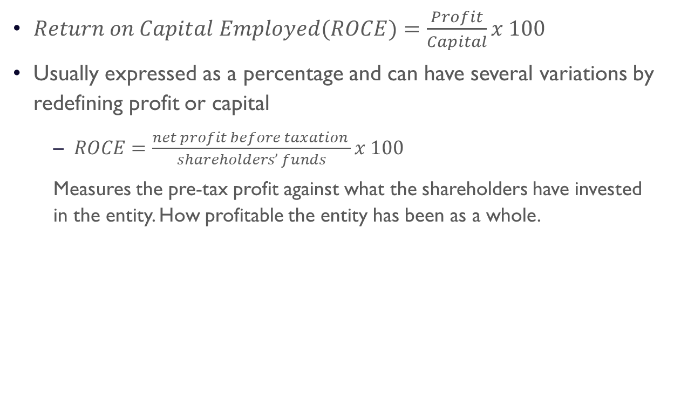
Profitability ratios
$Return on Capital Employed(ROCE)=\frac{Profit}{Capital}x 100$
Usually expressed as a percentage and can have several variations by redefining profit or capital
  $ROCE=\frac{net profit before taxation }{shareholders’ funds}x 100$
  Measures the pre-tax profit against what the shareholders have invested in the entity. How profitable the entity has been as a whole.

Slide 29
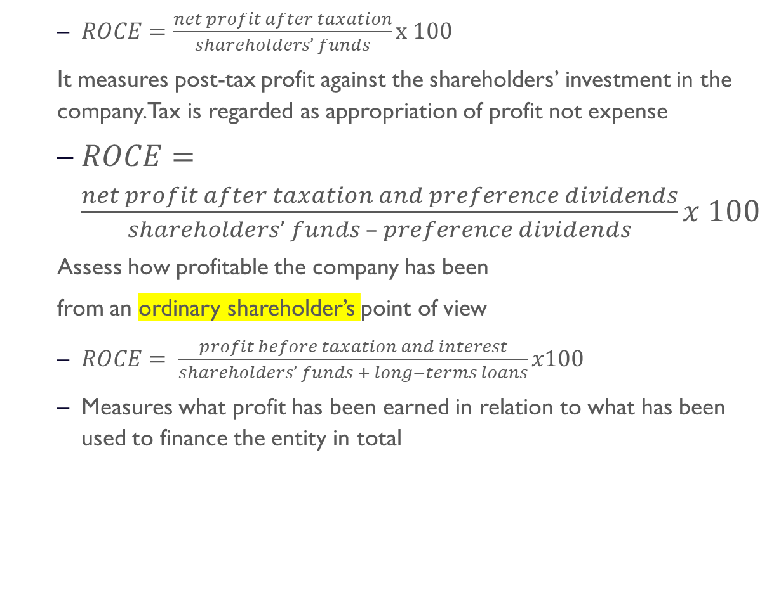
  $ROCE=\frac{net profit after taxation}{shareholders’ funds}x 100$
  It measures post-tax profit against the shareholders’ investment in the company. Tax is regarded as appropriation of profit not expense
  $ROCE=\frac{net profit after taxation and preference dividends}{shareholders’ funds – preference dividends}x 100$
  Assess how profitable the company has been
  from an ordinary shareholder’s point of view
  $ROCE= \frac{profit before taxation and interest}{shareholders’ funds + long−terms loans}x100$
  Measures what profit has been earned in relation to what has been used to finance the entity in total

Slide 30
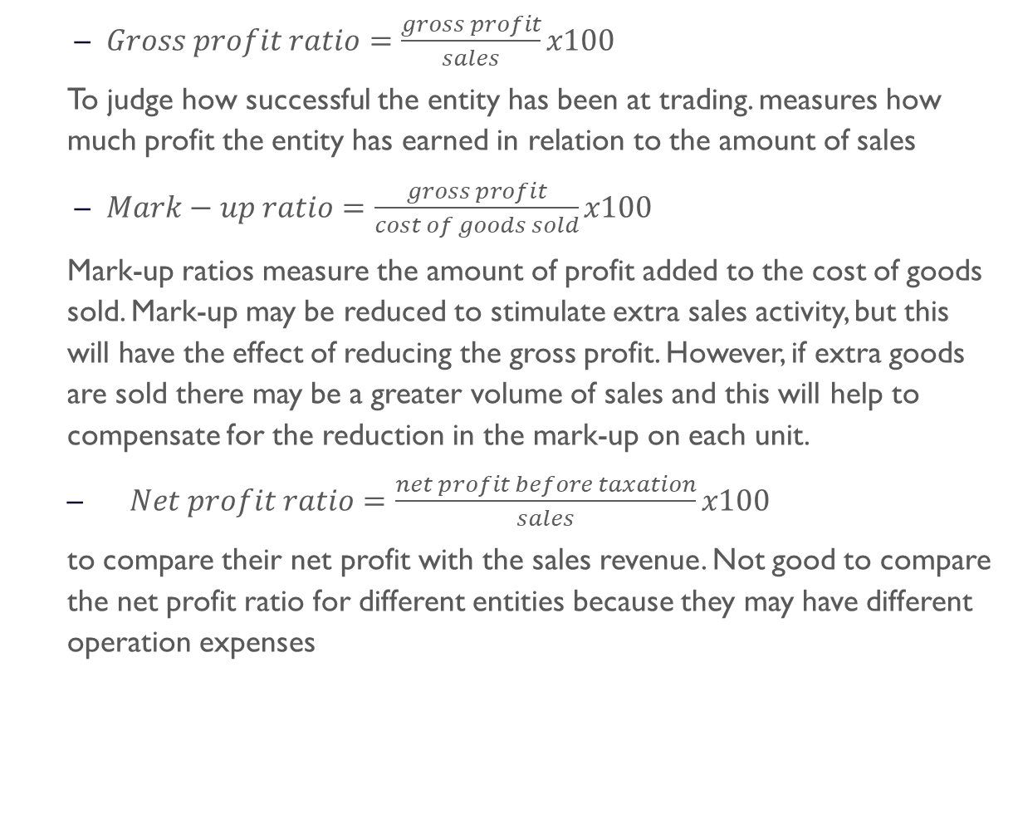
  $Gross profit ratio=\frac{gross profit}{sales}x100$
  To judge how successful the entity has been at trading. measures how much profit the entity has earned in relation to the amount of sales
  $Mark−up ratio=\frac{gross profit}{cost of goods sold}x100$
  Mark-up ratios measure the amount of profit added to the cost of goods sold. Mark-up may be reduced to stimulate extra sales activity, but this will have the effect of reducing the gross profit. However, if extra goods are sold there may be a greater volume of sales and this will help to compensate for the reduction in the mark-up on each unit.
  $Net profit ratio=\frac{net profit before taxation}{sales}x100$
  to compare their net profit with the sales revenue. Not good to compare the net profit ratio for different entities because they may have different operation expenses

Slide 31
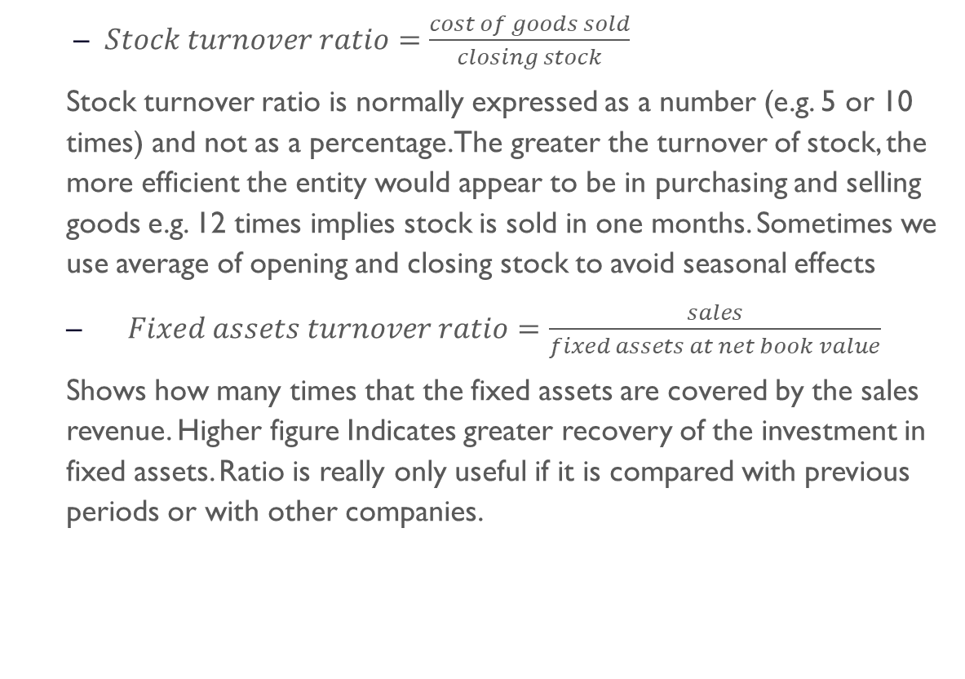
Efficiency ratios
  $Stock turnover ratio=\frac{cost of goods sold}{closing stock}$
  Stock turnover ratio is normally expressed as a number (e.g. 5 or 10 times) and not as a percentage. The greater the turnover of stock, the more efficient the entity would appear to be in purchasing and selling goods e.g. 12 times implies stock is sold in one months. Sometimes we use average of opening and closing stock to avoid seasonal effects
  $Fixed assets turnover ratio=\frac{sales}{fixed assets at net book value}$
  Shows how many times that the fixed assets are covered by the sales revenue. Higher figure Indicates greater recovery of the investment in fixed assets. Ratio is really only useful if it is compared with previous periods or with other companies.

Slide 32
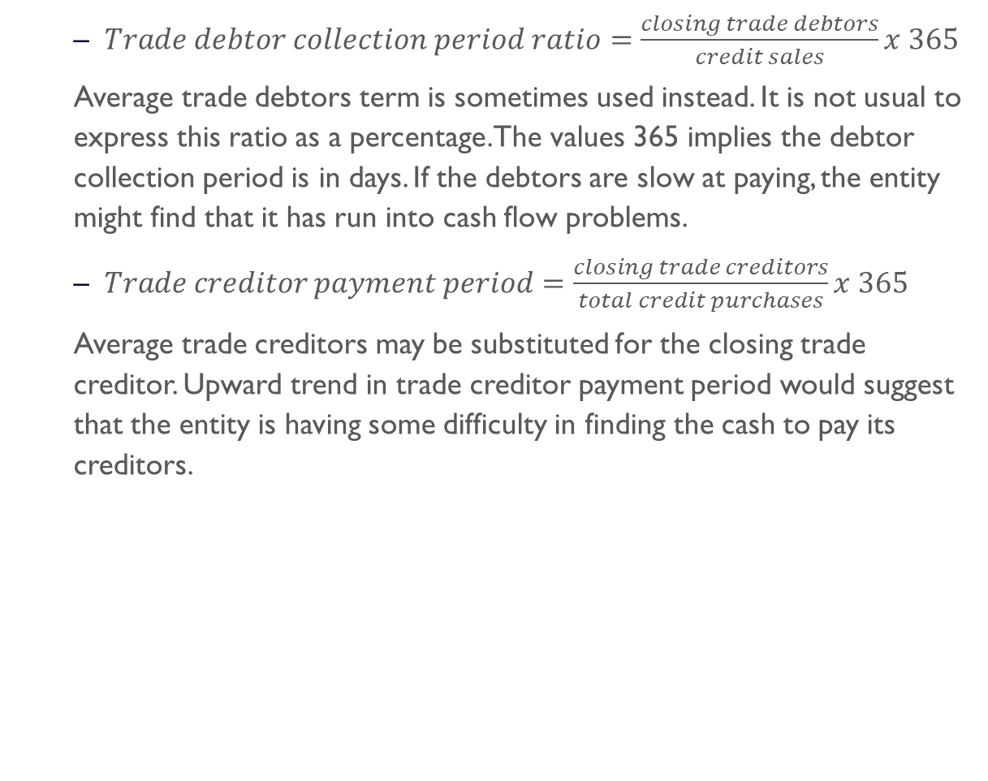
  $Trade debtor collection period ratio=\frac{closing trade debtors}{credit sales}x 365$
  Average trade debtors term is sometimes used instead. It is not usual to express this ratio as a percentage. The values 365 implies the debtor collection period is in days. If the debtors are slow at paying, the entity might find that it has run into cash flow problems.
  $Trade creditor payment period=\frac{closing trade creditors}{total credit purchases}x 365$
  Average trade creditors may be substituted for the closing trade creditor. Upward trend in trade creditor payment period would suggest that the entity is having some difficulty in finding the cash to pay its creditors.

Slide 33
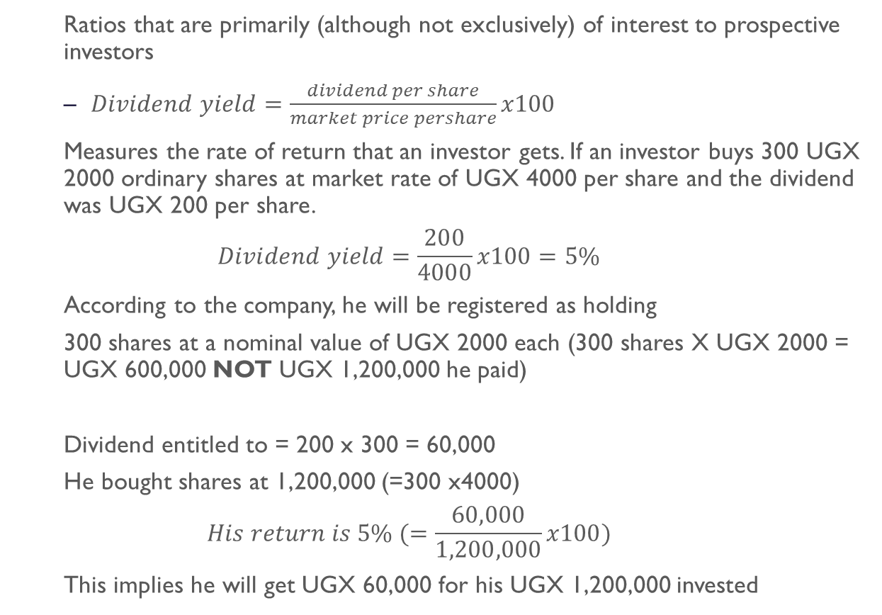
Investment ratios
  Ratios that are primarily (although not exclusively) of interest to prospective investors
  $Dividend yield=\frac{dividend per share}{market price pershare}x100$
  Measures the rate of return that an investor gets. If an investor buys 300 UGX 2000 ordinary shares at market rate of UGX 4000 per share and the dividend was UGX 200 per share.
  $$Dividend yield=\frac{200}{4000}x100=5\%$$
  According to the company, he will be registered as holding
  300 shares at a nominal value of UGX 2000 each (300 shares X UGX 2000 = UGX 600,000 NOT UGX 1,200,000 he paid)
  Dividend entitled to = 200 x 300 = 60,000
  He bought shares at 1,200,000 (=300 x4000)
  $$His return is 5\% (=\frac{60,000}{1,200,000}x100)$$
  This implies he will get UGX 60,000 for his UGX 1,200,000 invested

Slide 34
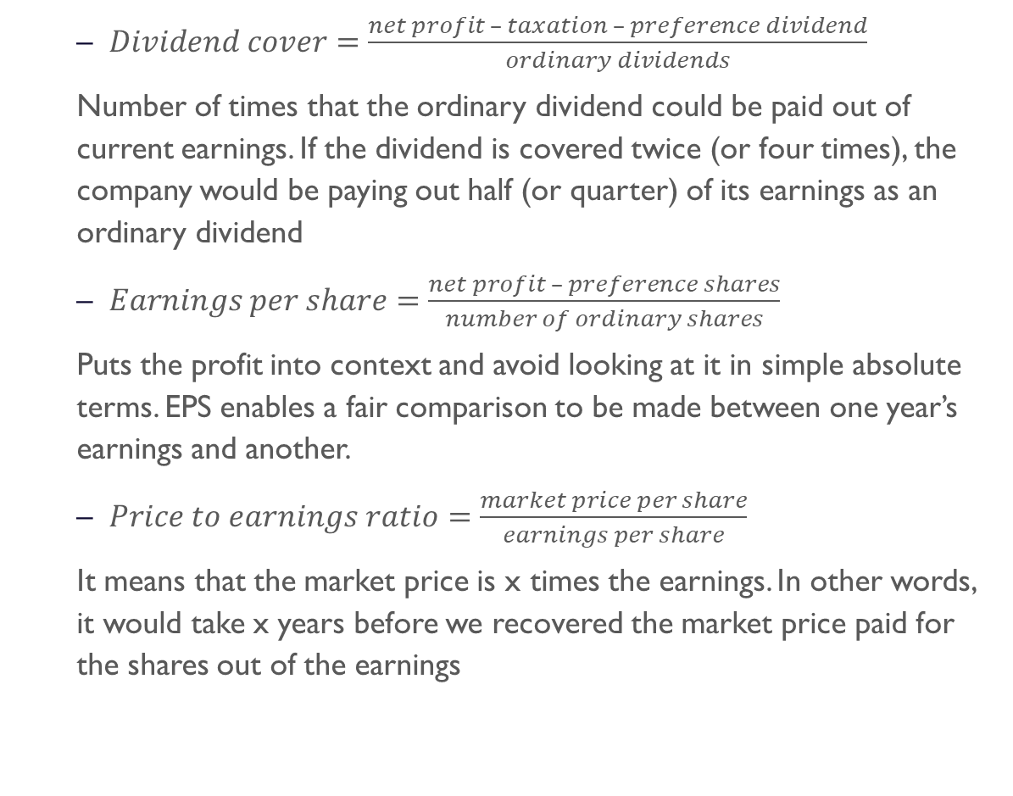
  $Dividend cover=\frac{net profit – taxation – preference dividend}{ordinary dividends}$
  Number of times that the ordinary dividend could be paid out of current earnings. If the dividend is covered twice (or four times), the company would be paying out half (or quarter) of its earnings as an ordinary dividend
  $Earnings per share=\frac{net profit – preference shares}{number of ordinary shares}$
  Puts the profit into context and avoid looking at it in simple absolute terms. EPS enables a fair comparison to be made between one year’s earnings and another.
  $Price to earnings ratio=\frac{market price per share}{earnings per share}$
  It means that the market price is x times the earnings. In other words, it would take x years before we recovered the market price paid for the shares out of the earnings

Slide 35
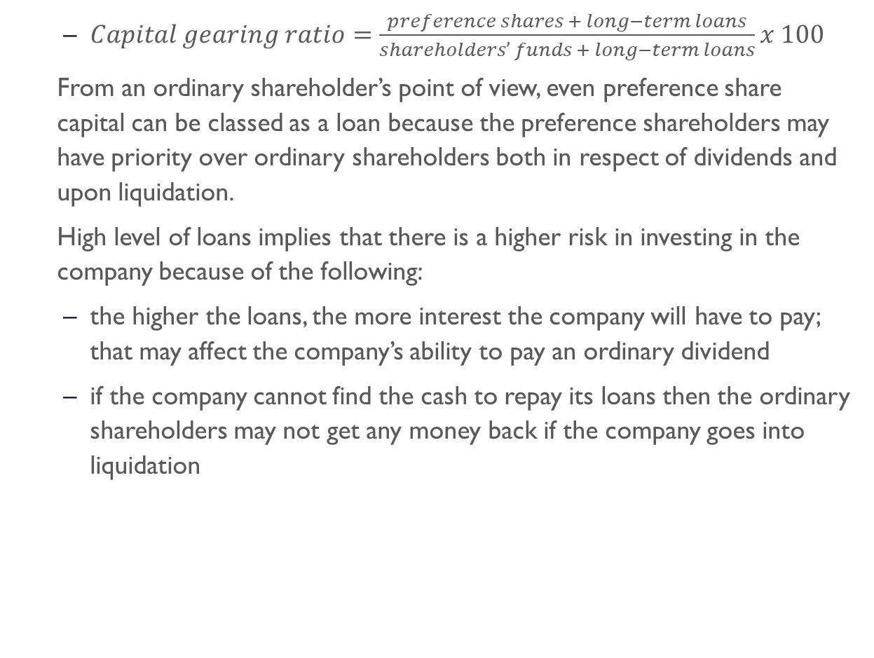
  $Capital gearing ratio=\frac{preference shares + long−term loans}{shareholders’ funds + long−term loans}x 100$
  From an ordinary shareholder’s point of view, even preference share capital can be classed as a loan because the preference shareholders may have priority over ordinary shareholders both in respect of dividends and upon liquidation.
  High level of loans implies that there is a higher risk in investing in the company because of the following:
  the higher the loans, the more interest the company will have to pay; that may affect the company’s ability to pay an ordinary dividend
  if the company cannot find the cash to repay its loans then the ordinary shareholders may not get any money back if the company goes into liquidation

Slide 36
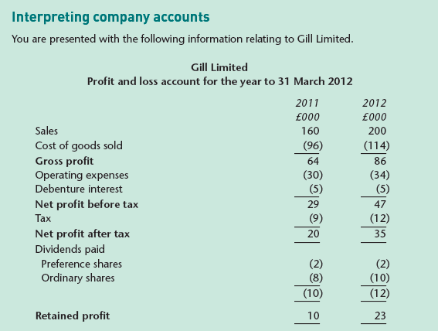

Slide 37
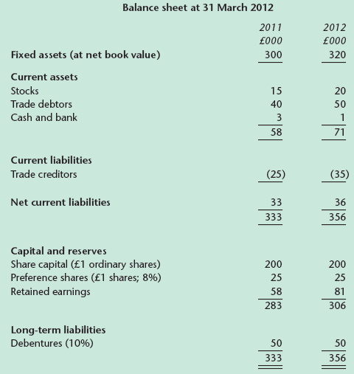

Slide 38
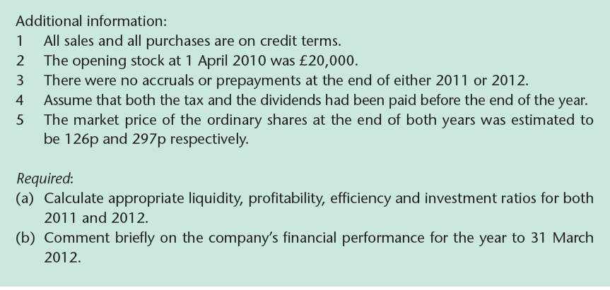

Slide 39
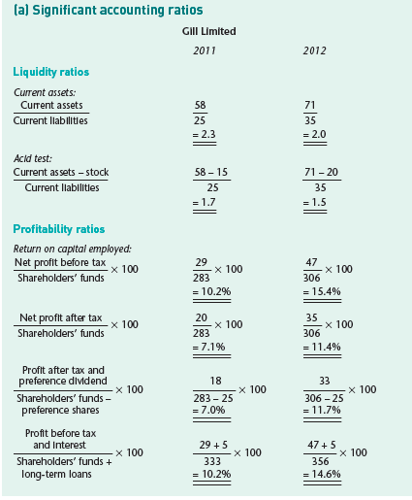
Solution

Slide 40
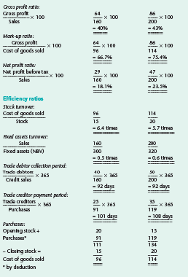

Slide 41
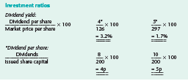
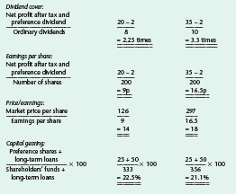
cu

Slide 42
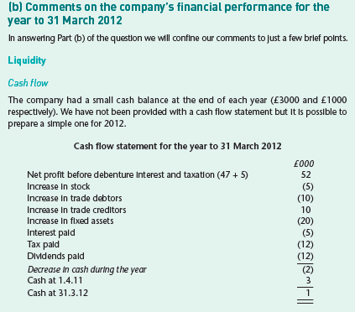


Slide 43
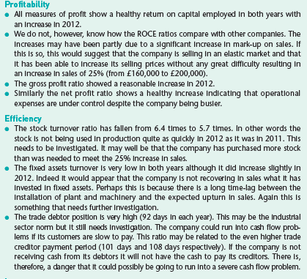

Slide 44
